Slide 1
4-Weekly presentation
Rhea Hau
15 November 2018

Slide 2
Review

Slide 3




Review Look back to the previous presentation
What did I do BEFORE the first 4-weekly presentation?
Research Proposal
Thesis
Scientific articles
Buy sensors
Test sensors

Slide 4



Review Look back to the previous presentation
What did I do AFTER the first 4-weekly presentation?
Collect and
Process data
Artificial Intelligence &
machine learning
~80-90% stress
Scientific articles
Train and test

Slide 5
So far…

Slide 6



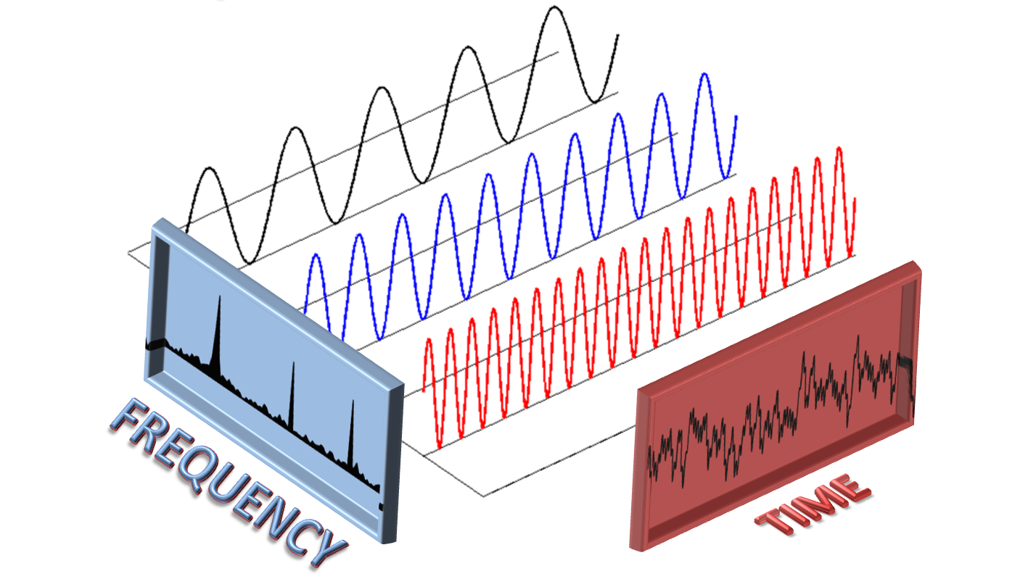
So far… Look back to the previous work
What did I do extra AFTER the first 4-weekly presentation?
Data in Comma Separated View and JavaScript Object Notation files
Collect and
Process data
Scientific articles
Fourier Transform

Slide 7
Sensors

Slide 8
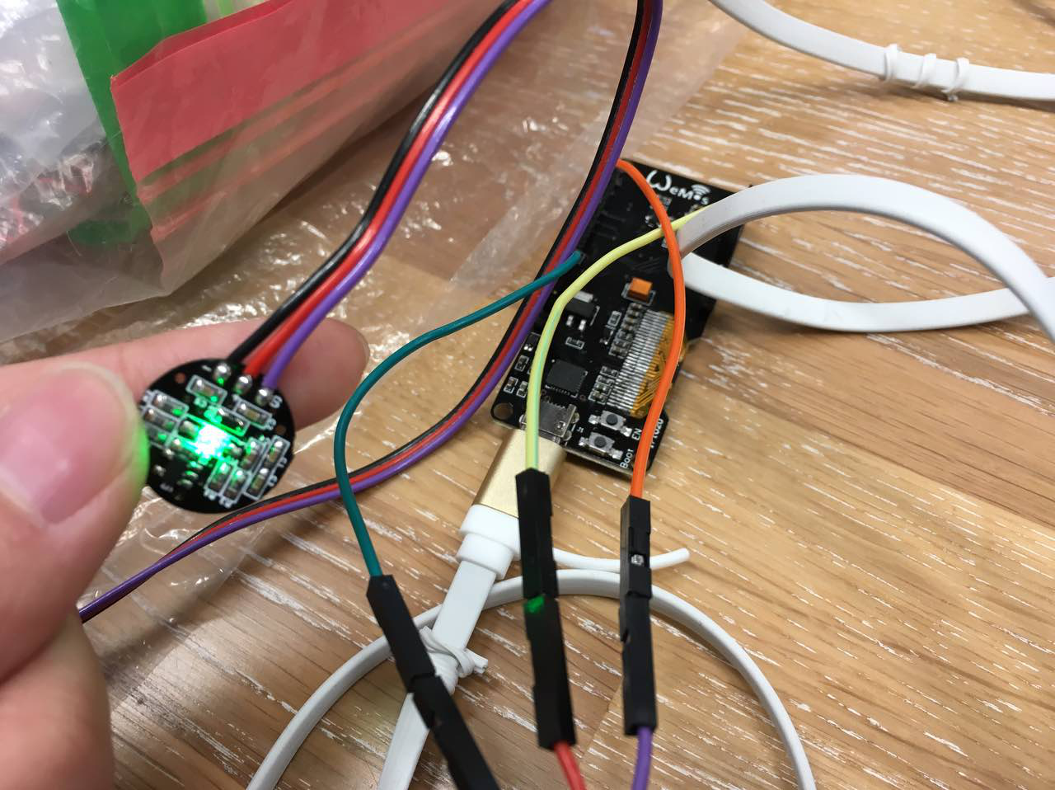
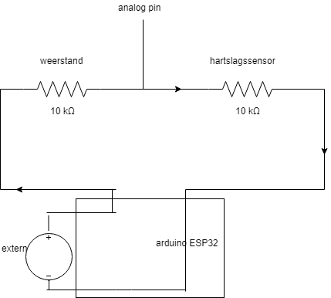
Pulse sensor

Slide 9
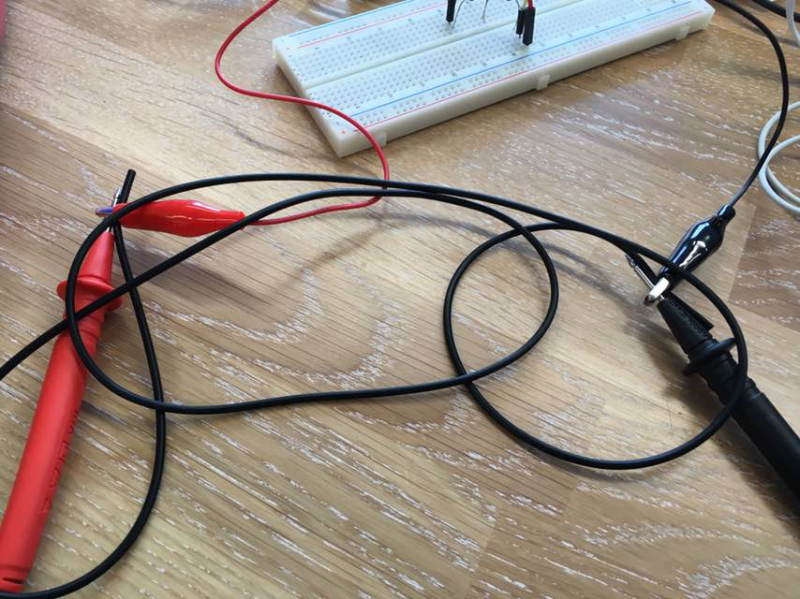
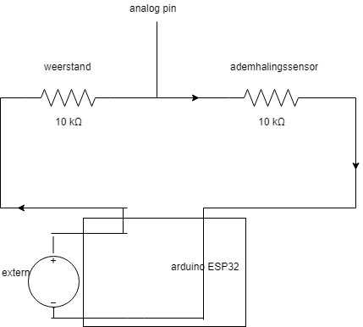
Breath sensor Conductive rubber cord stretch sensor

Slide 10
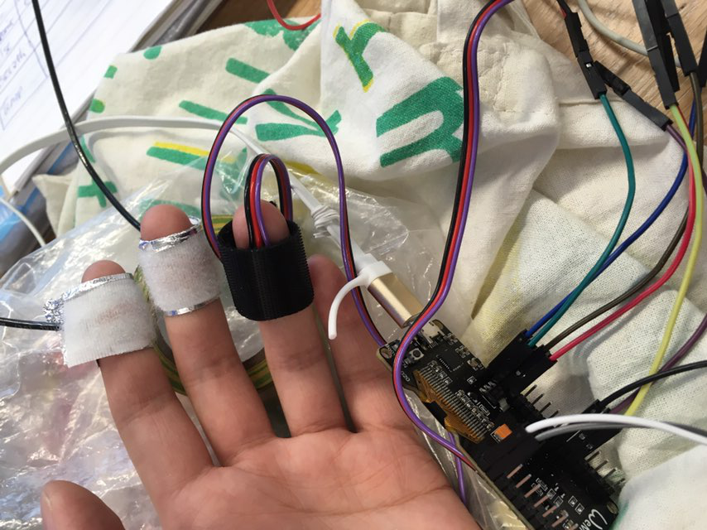
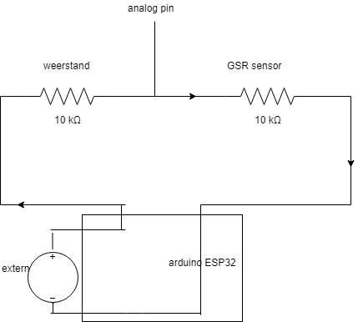
GSR sensor Galvanic Skin Response sensor

Slide 11
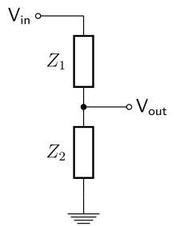
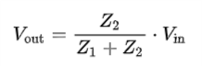
Voltage divider
Z1 = resistor
Z2 = sensor

Slide 12
Data transport

Slide 13
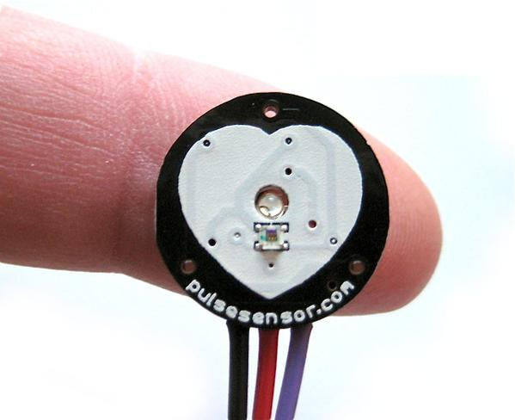

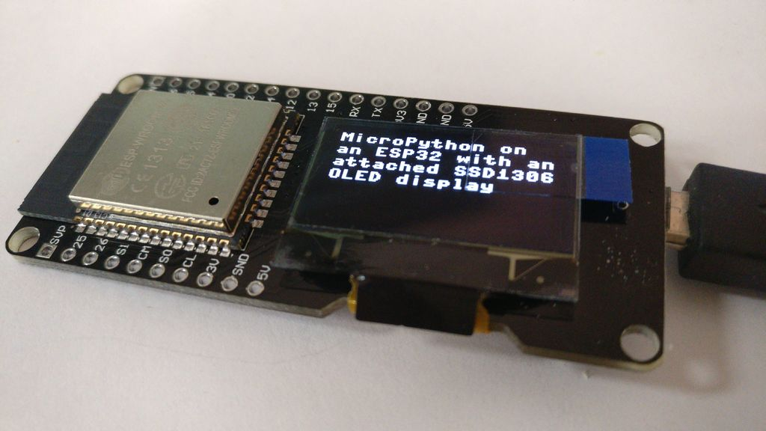
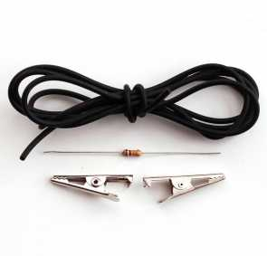
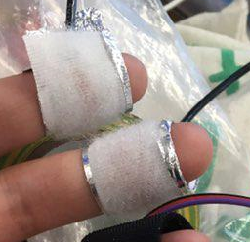

Software for ESP32

Slide 14
Software for PC
&

Slide 16
Fourier transform

Slide 17
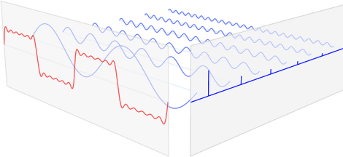
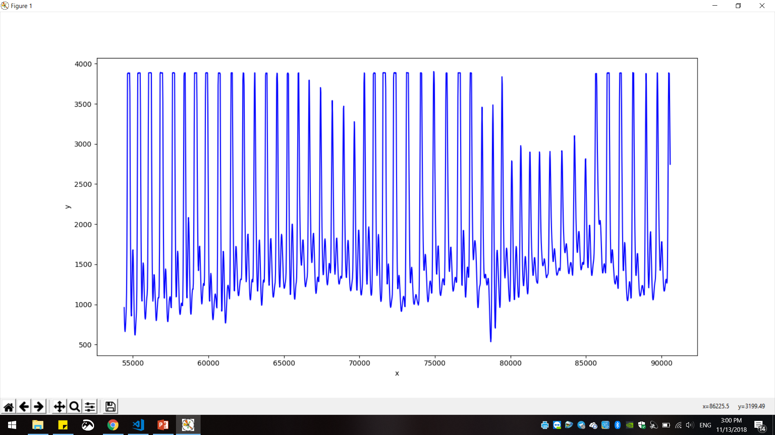
Fourier transform

Slide 18
Planner

Slide 19
Planning

Slide 20
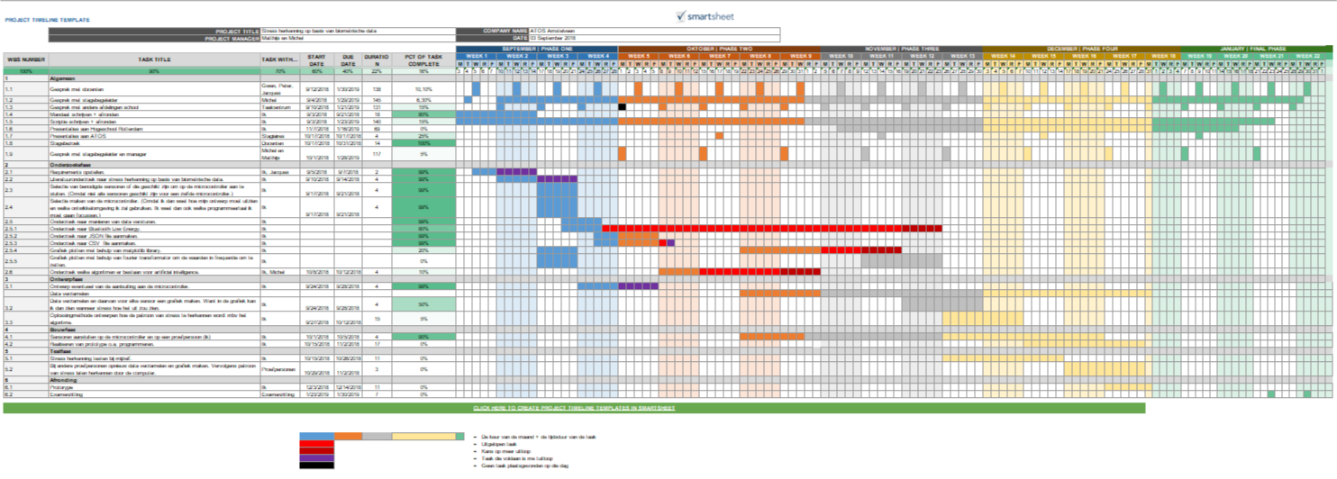
Follow-up plan

Slide 21
Thank you for your attention For more information please contact: Rhea.Hau@atos.net

